Slide 1
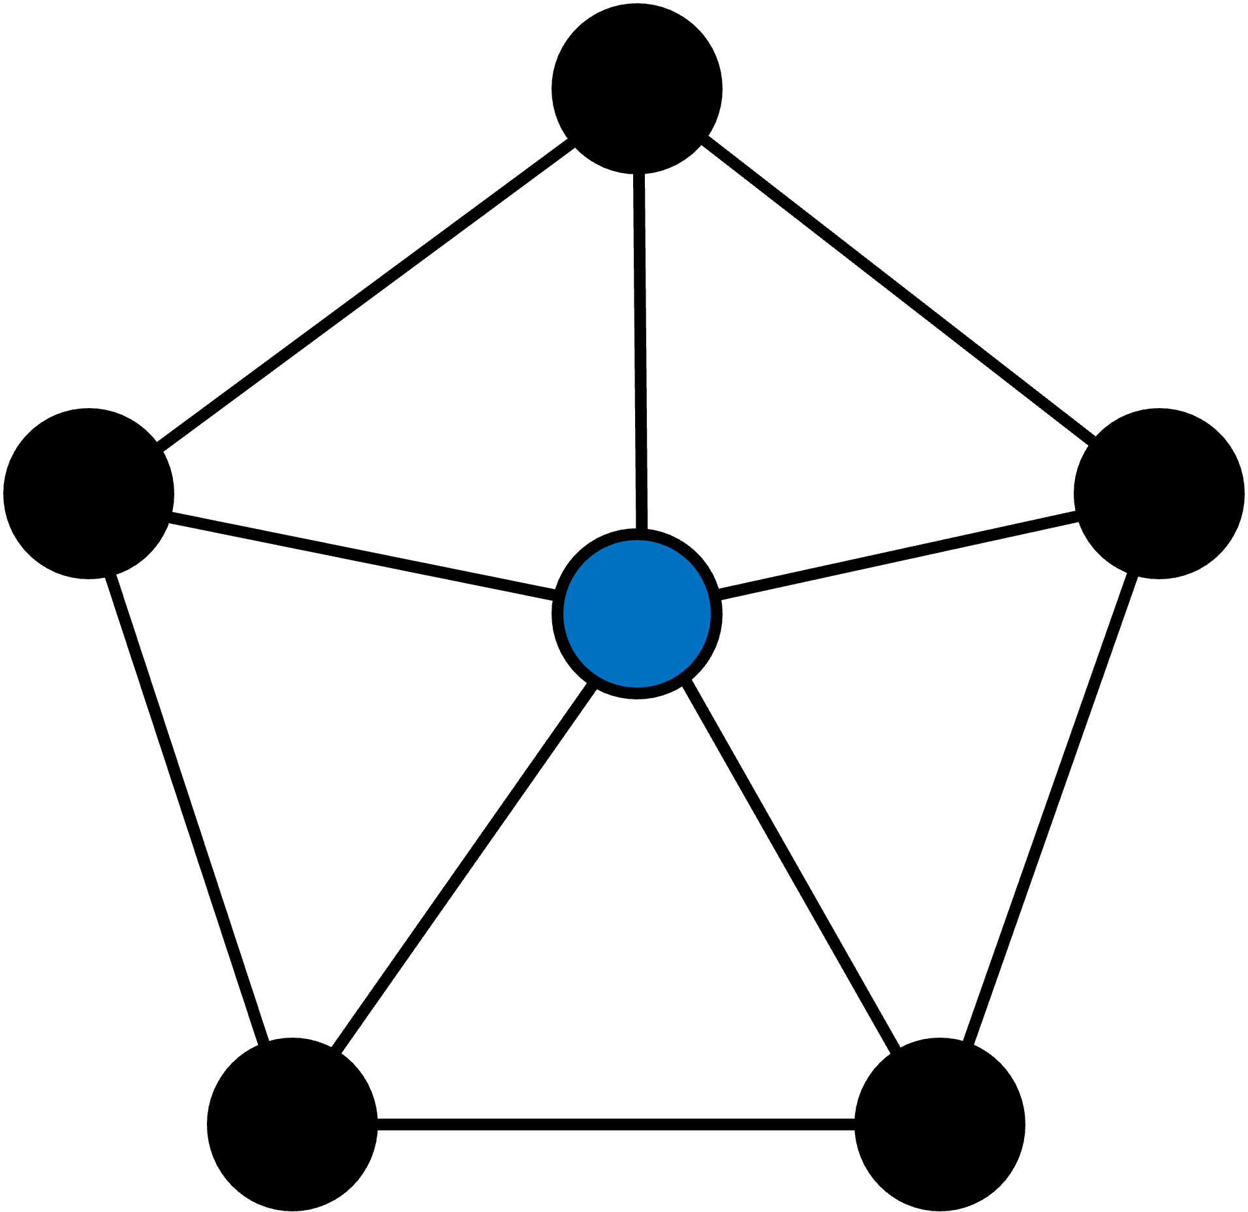
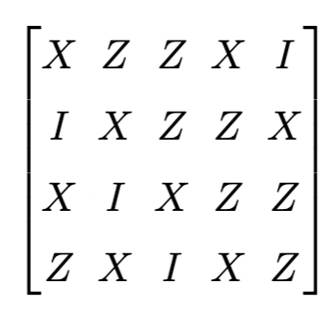
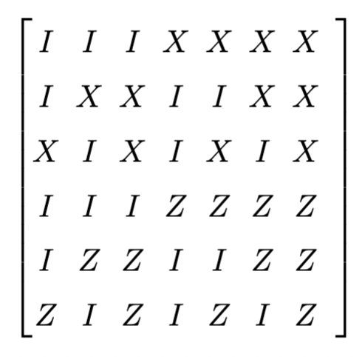
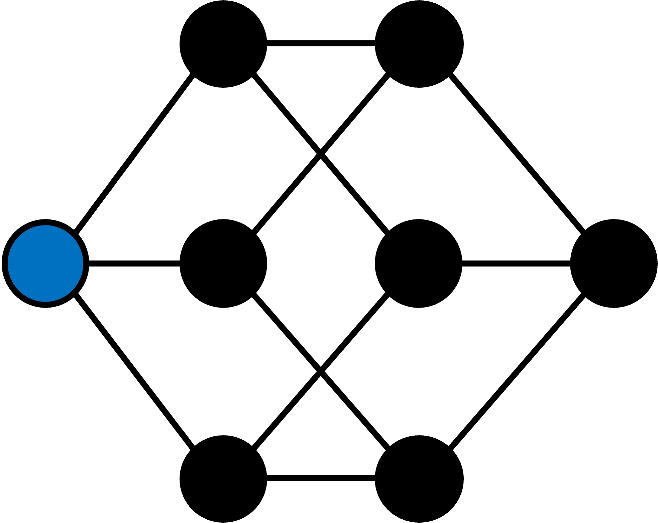
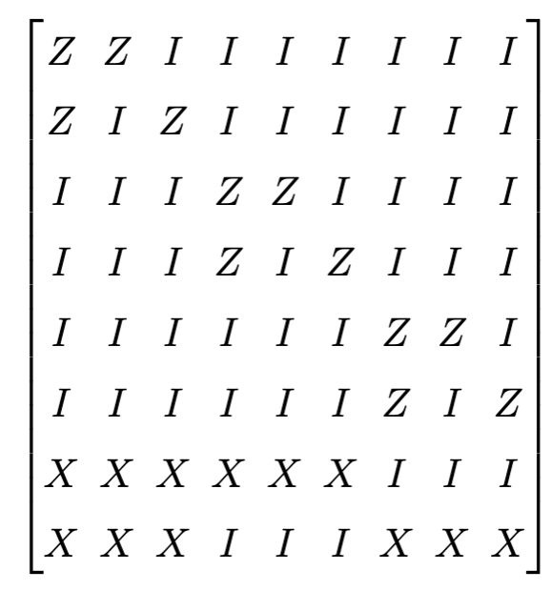
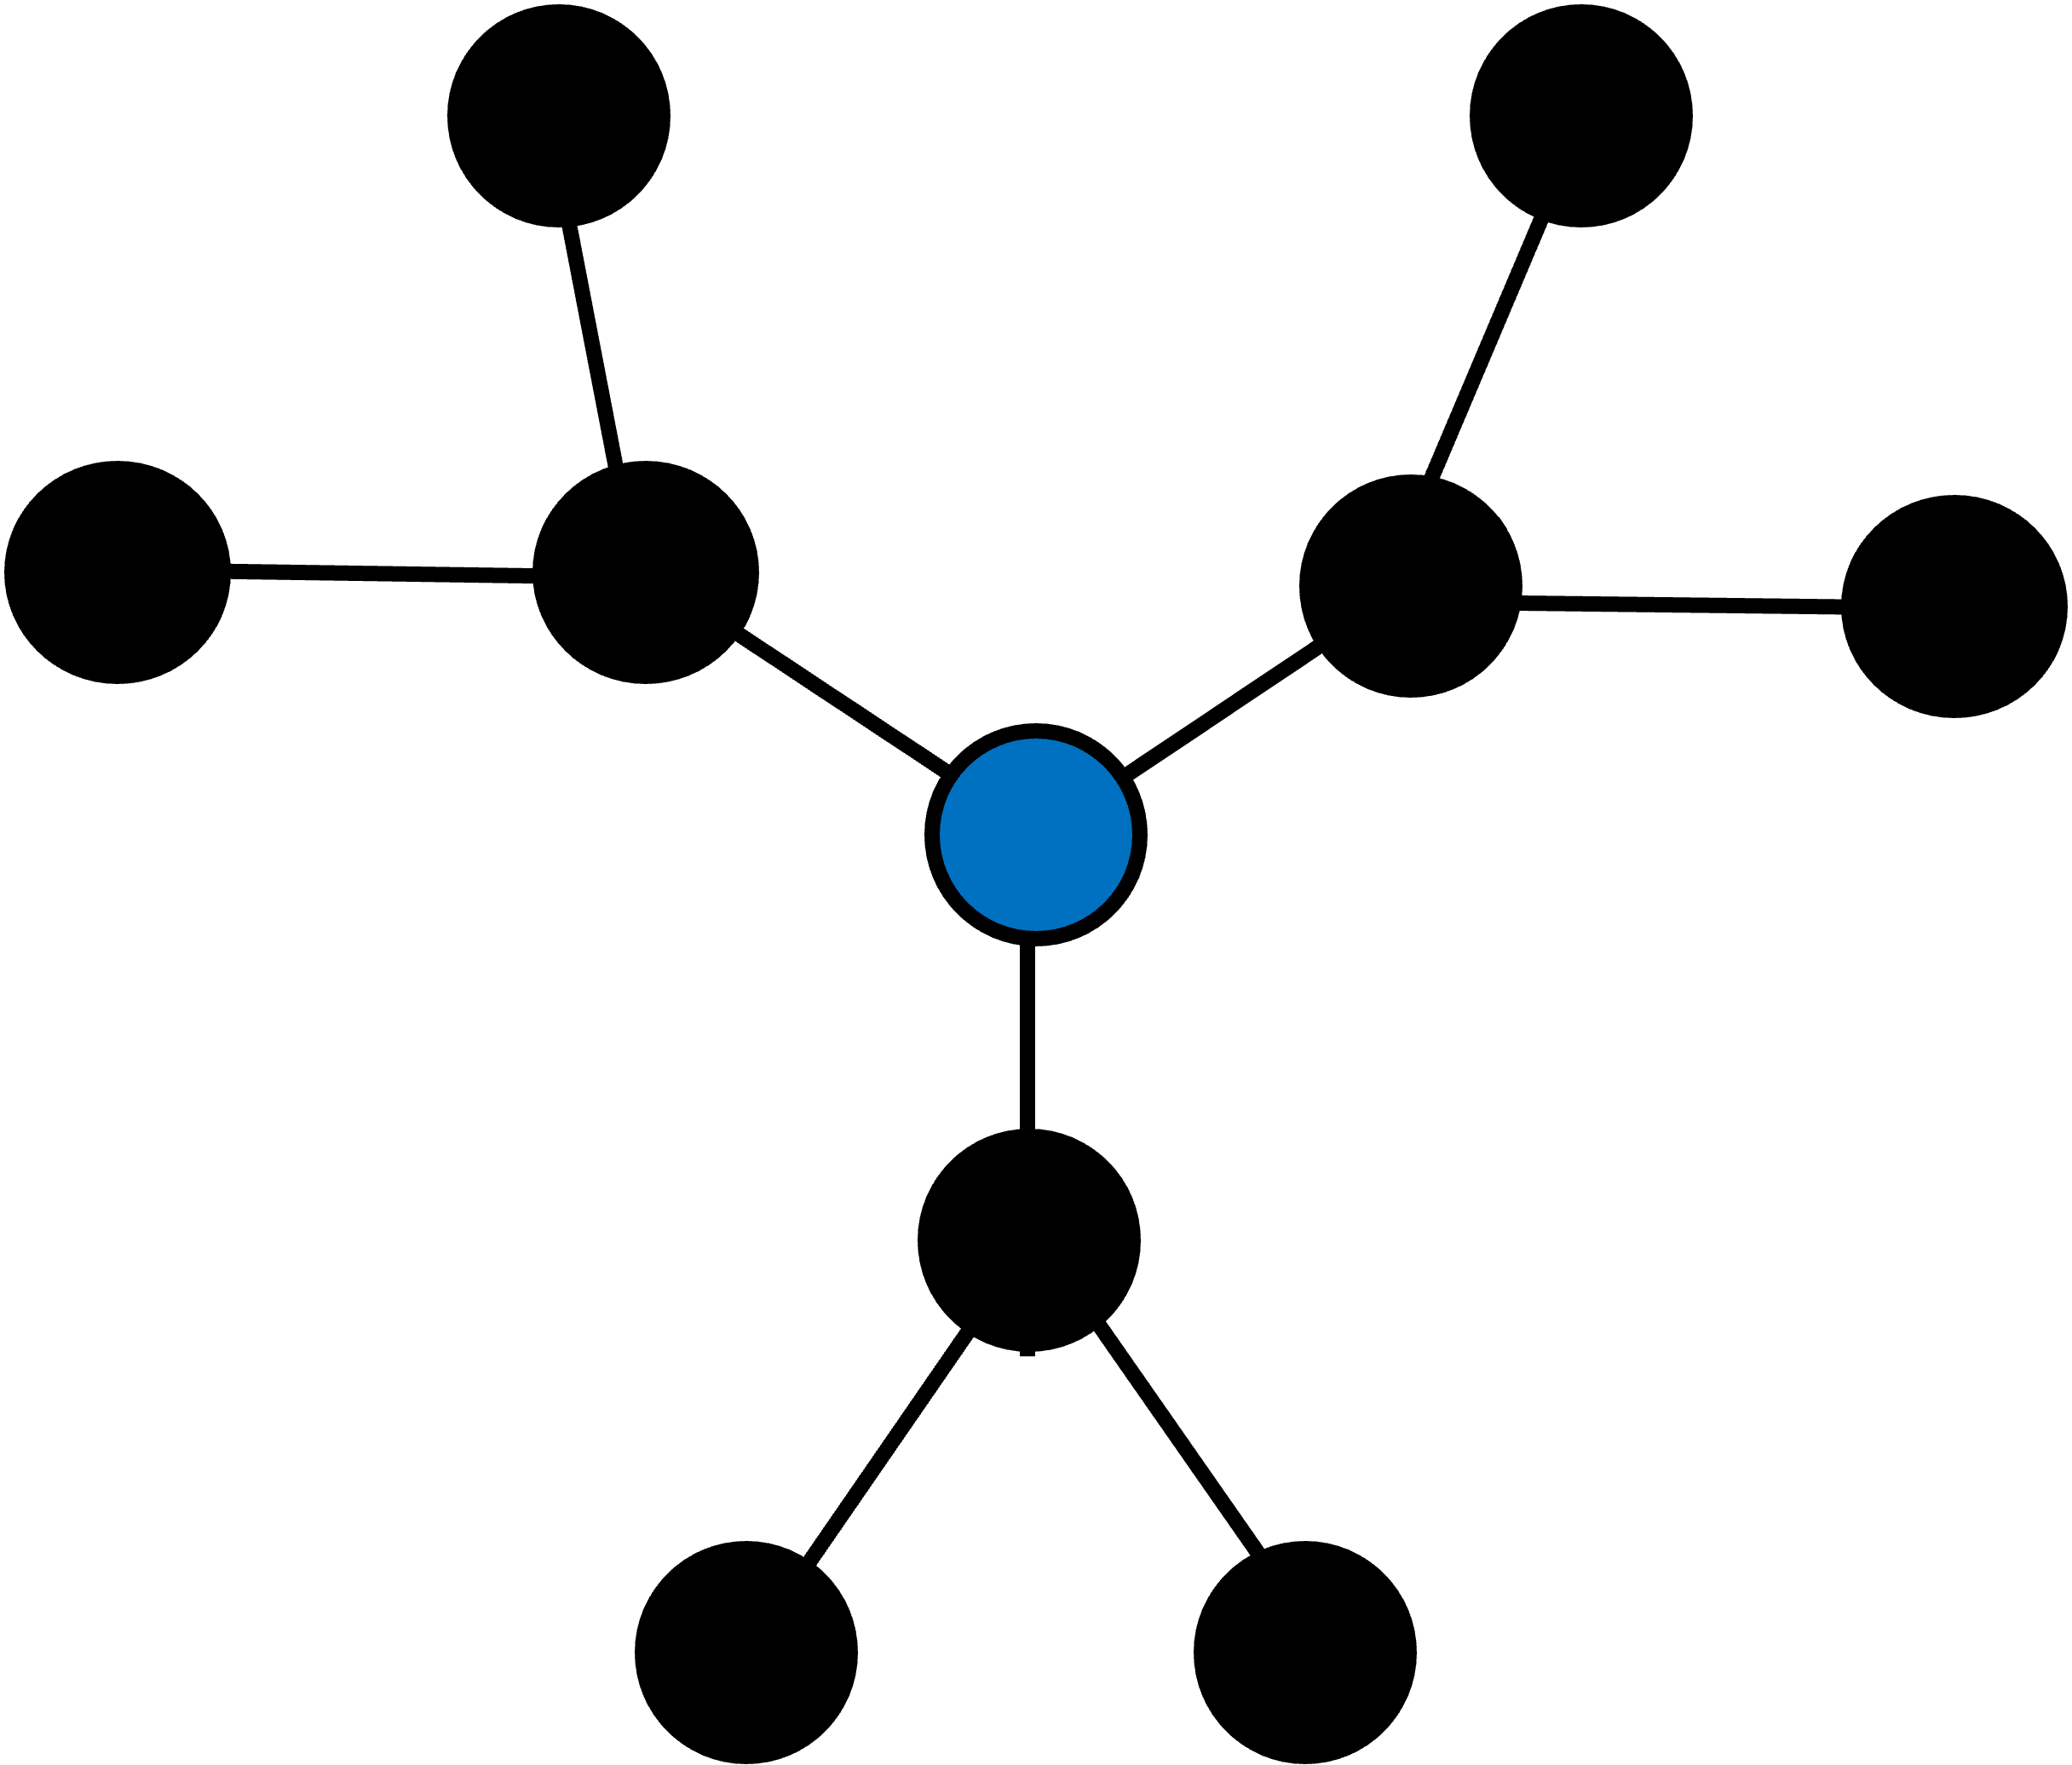


Universal graph representation of stabilizer codes
(a)
Scientific Achievement
We demonstrate that graph theory can give significant insight into quantum error correction. We prove an exact universal correspondence between stabilizer codes and graphs. We unify key coding algorithms—weight reduction, decoding, distance approximation—into strategies of a single one-player game on a graph. We use graph theory to design new codes with good rate/distance, build efficient decoders with provable guarantees on certain codes, and systematically implement certain Clifford and non-Clifford gates.
Significance & Impact
The stabilizer formalism of quantum codes has served as a very useful tool to describe quantum codes, but not to construct them. By converting stabilizer codes entirely into graphs, we open a path towards a fully general recipe to construct stabilizer codes by finding graphs with sufficiently nice topological, geometric, etc. properties. Similarly, algorithm construction can be reduced to studying strategies for the unified game on the graph. Our work is especially useful for developing codes that work specifically for a desired experimental implementation with given constraints.
(b)
Details
We construct a family of graphs that is in bijection with the set of stabilizer codes, represented by tableaus. We give an efficient algorithm mapping tableaus to graphs and vice versa.
Famous codes turn into simple geometric shapes in the graph representation, e.g. a cube. The degree of the graph upper bounds key properties like distance and stabilizer weight.
We build new codes based on familiar graphs. We introduce the dodecahedral code, which is a non-CSS code that strictly improves upon the 5-qubit code. We introduce the hypercubic code family, which has high rate and good distance at small scales.
We prove that error correction algorithms can be represented in a unified way as strategies on a modified version of the game “Lights Out!” and call it Quantum Lights Out (QLO). We show that a greedy QLO strategy efficiently decodes the hypercubic code, lower bounding the distance.
We use graphs to prove that random codes have bounded stabilizer weight and high distance.
(c)
Figure: Correspondence between the graph representation and the tableau representation for (a) the 5-qubit code, (b) the 7-qubit Steane code, and (c) the 9-qubit Shor code.
Khesin, A. B., Lu, J. Z., & Shor, P. W. (2024). Universal graph representation of stabilizer codes. arXiv preprint arXiv:2411.14448.

Slide 2
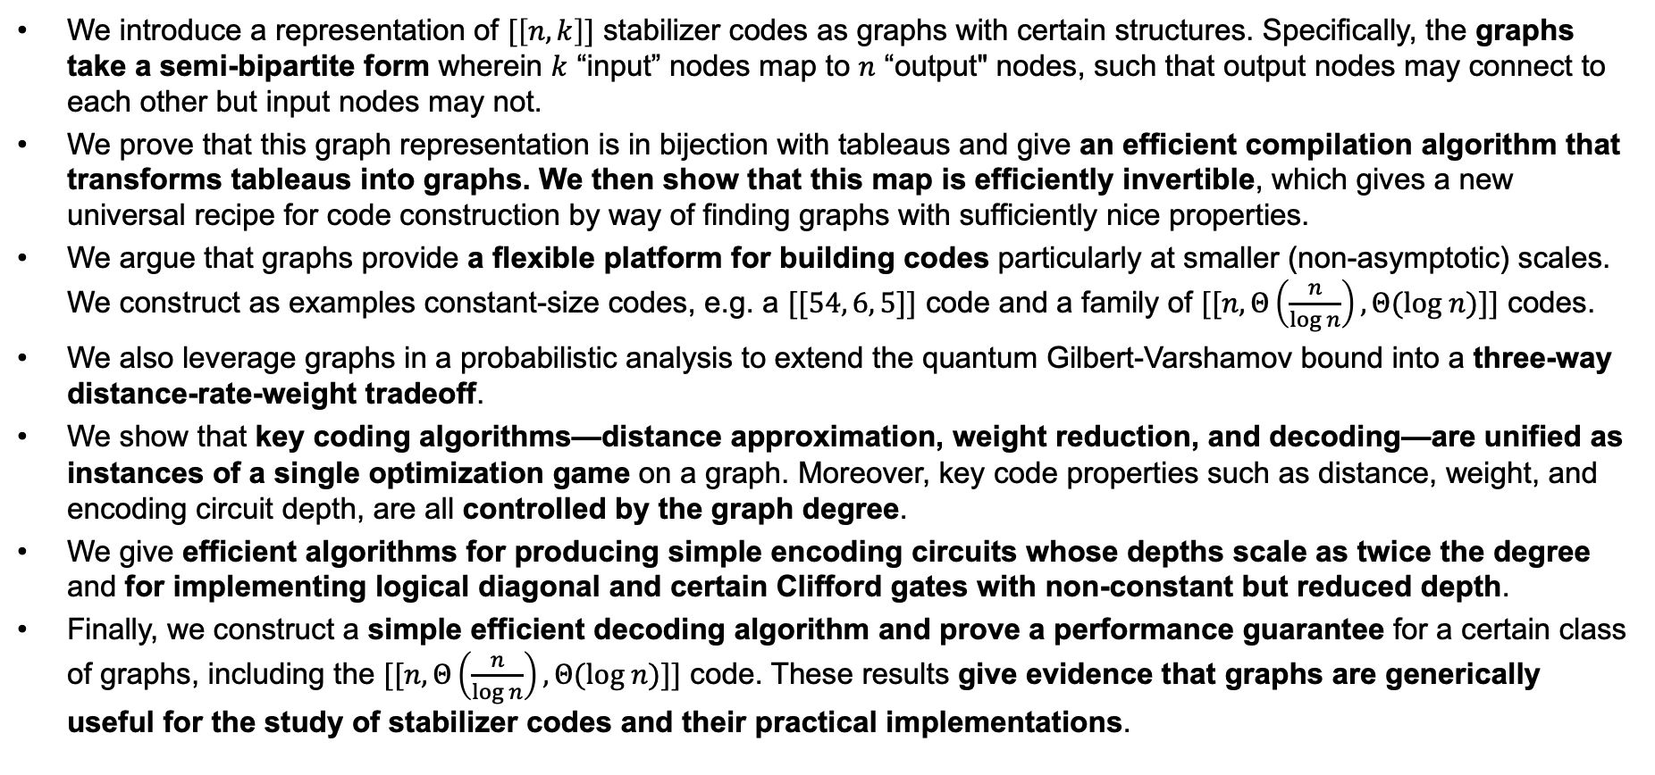
Highlights – What we did
We introduce a representation of $[\left[n, k\right]]$ stabilizer codes as graphs with certain structures. Specifically, the graphs take a semi-bipartite form wherein $k$ “input” nodes map to $n$ “output" nodes, such that output nodes may connect to each other but input nodes may not.
We prove that this graph representation is in bijection with tableaus and give an efficient compilation algorithm that transforms tableaus into graphs. We then show that this map is efficiently invertible, which gives a new universal recipe for code construction by way of finding graphs with sufficiently nice properties.
We argue that graphs provide a flexible platform for building codes particularly at smaller (non-asymptotic) scales. We construct as examples constant-size codes, e.g. a $[[54, 6, 5]]$ code and a family of $[[n, Θ\left(\frac{n}{log n}\right), Θ(log n)]]$ codes.
We also leverage graphs in a probabilistic analysis to extend the quantum Gilbert-Varshamov bound into a three-way distance-rate-weight tradeoff.
We show that key coding algorithms—distance approximation, weight reduction, and decoding—are unified as instances of a single optimization game on a graph. Moreover, key code properties such as distance, weight, and encoding circuit depth, are all controlled by the graph degree.
We give efficient algorithms for producing simple encoding circuits whose depths scale as twice the degree and for implementing logical diagonal and certain Clifford gates with non-constant but reduced depth.
Finally, we construct a simple efficient decoding algorithm and prove a performance guarantee for a certain class of graphs, including the $[[n, Θ\left(\frac{n}{log n}\right), Θ(log n)]]$ code. These results give evidence that graphs are generically useful for the study of stabilizer codes and their practical implementations.

